Slide 1
2021-2025 Rule Changes
Youth and Girls/Women

Slide 2
Major In-Game Rule Changes
No shorthanded icing at any level
Every major requires a game misconduct
Immediate offsides at all levels*
D-zone faceoffs after a penalty*
Minimum penalty durations*
Individual & team penalty limitations: 4/12 instead of 5/15*
2nd instance of abuse from the bench is a GM*
“Reckless endangerment” for determination of major*
Notes:
Icing and immediate offsides rules are done for player development purposes
No possibility of opting out of these rules if it’s a USA Hockey game
Lots of passion on both sides. The official’s job is to enforce the rules as written and interpreted.

Slide 3
Other Meaningful Rule Changes
Standardized discipline for match penalties
Injured players as Team Personnel
Stick length extended to 65”
Stricter penalties for coaches who get 2nd and 3rd GM for abuse of officials during the same season
Neck guards still recommended
Notes:
Standardized match penalty suspensions are the Preface section of the rulebook on page XXX

Slide 4
Immediate Offsides
Intentional offsides occurs when
Done to deliberately secure a stoppage of play
There is no chance of a legal play at the blue line
A “timing play” dump-in or shot on goal is not automatically considered intentional.
A dump-in or shot on goal with players clearly not close to the blue line can be considered intentional.

Slide 5
D-zone Faceoff After Penalty
Exceptions
Does not affect on-ice strength
Start/End of period
After a goal
Attacking defenseman enters beyond tops of circles during a scrum
Stoppage of play by the non-offending team
Officials decide faceoff side.
Notes:
Coincidentals
Team on the PP takes a penalty - penalty makes teams even strength but DOES affect on-ice strength

Slide 6
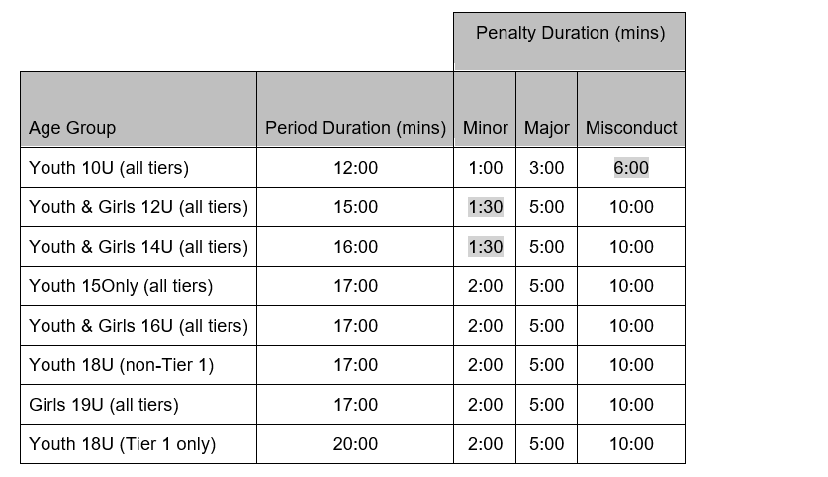
CHC Period and Penalty Durations
Period length dictates minor penalty duration.
Period length Minor
12 min or less 1:00
13-16 min 1:30
17-20 min 2:00
For games played in halves, divide total game time by three to get period length.
Changes from 2020-2021 season highlighted
Notes:
Does not apply to CHC

Slide 7
Penalty Limitations
After fourth penalty to a player, the player will be immediately ejected from the game and receive a game misconduct.
If a team incurs twelve or more penalties, calculated at the end of the game, the coach of record at the time of the twelfth penalty will be suspended for one game.
Player example
Checking from behind & charging to same player in same game
Minor + misc, minor + GM, GM for four penalties

Slide 8
Second Instance of Abuse of Officials
When second instance of abuse from anyone on the bench is clearly a continuation of abuse, a game misconduct may be assessed instead of a second bench minor.
When a player on the bench can be identified, they will be assessed the appropriate penalties instead of the team.
If a head coach earns a bench minor for abuse and after that penalty has expired an assistant coach abuses the officials for the same situation, the assistant coach is subject to a game misconduct.
Notes:
Last season the GM applied only if the bench minor will still being served.

Slide 9
Reckless Endangerment vs Injury
“Engaging in conduct, without regard to the consequences, which creates a substantial risk of serious physical injury to an opponent.”
Officials have discretion on whether an action was reckless, whether or not an injury occurs.
The emphasis for the officials is primarily on the action.
Players cannot draw an automatic major+GM by feigning injury.
A major+GM may be assessed even though there is no injury.

Slide 10
Contact Information
Kevin Redding
USA Hockey Referee-in-Chief for CT
ctric@chchockey.org
Twitter: cthockeyrefs
Notes:
Icing and immediate offsides rules are done for player development purposes
Lots of passion on both sides. The official’s job is to enforce the rules as written and interpreted.

